Slide 1
Combinatorial
Presented:Burak ELHAMAN

Slide 2
Titles
FPGA
First project
Second project
Conclusion

Slide 3
FPGA
FPGA is mean Field Programmable Gate Array
FPGA can operate at high frequencies and has a parallel operation
FPGA has two programmable species HDL and Block design, HDL has two option Verilog HDL and VHDL

Slide 4
First project
Introduction
We have 3 input and 4 output and prepared logic device for “2 from 4”
On the output we have two ‘1’
All outputs different each other

Slide 5
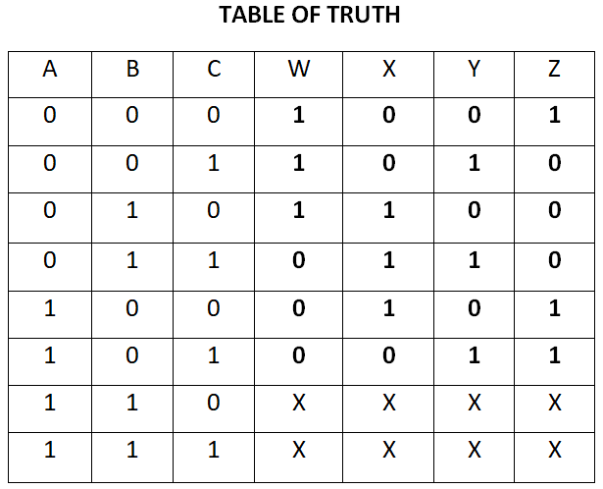
First project
Table of truth

Slide 6
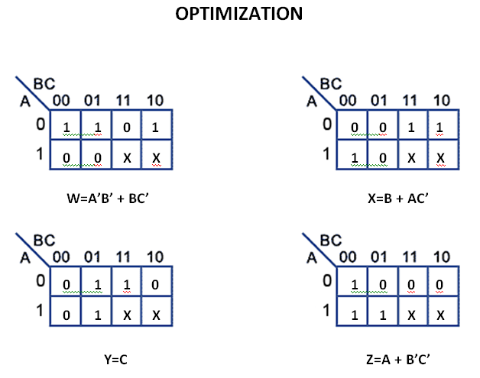
First project
Karnaugh Map

Slide 7
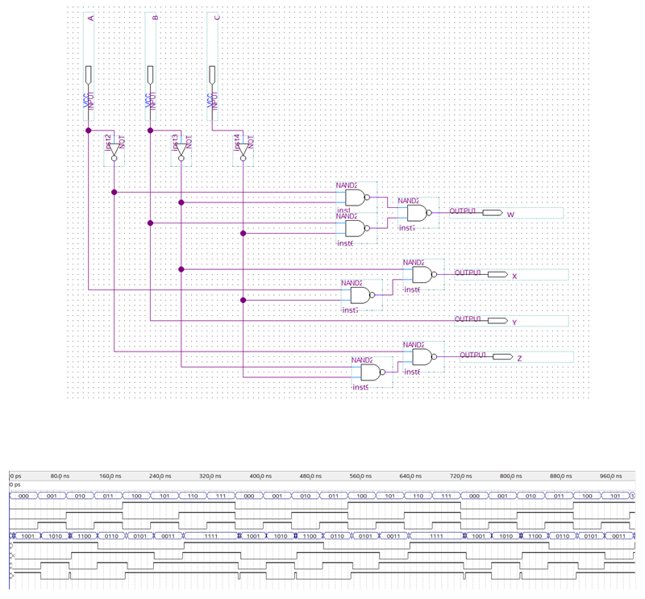
First project
Gate
realization
and analysis

Slide 8
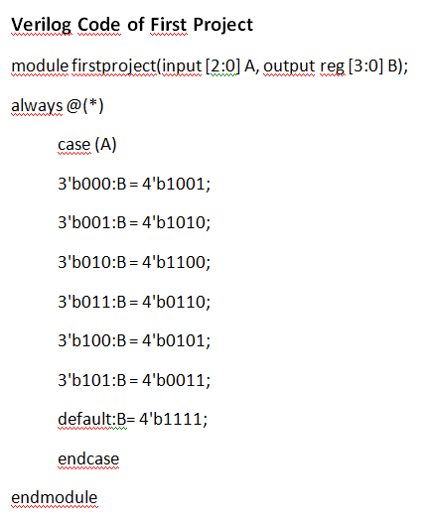
First project
Verilog code

Slide 9
Second project
Introduction
We prepared decoder for 7 segment display from BCD or binary
We have four input and seven output
It show us from 0 to 9

Slide 10
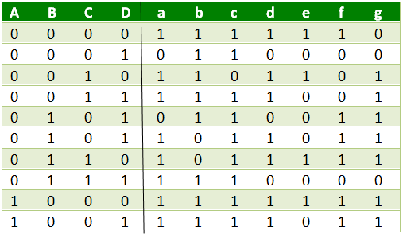
Second project
Firt we should prepare Table of truth

Slide 11
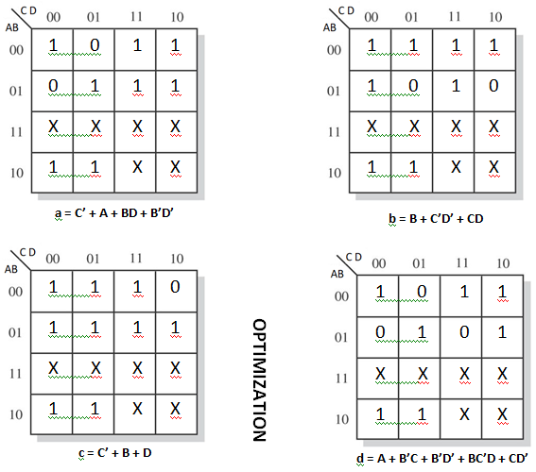
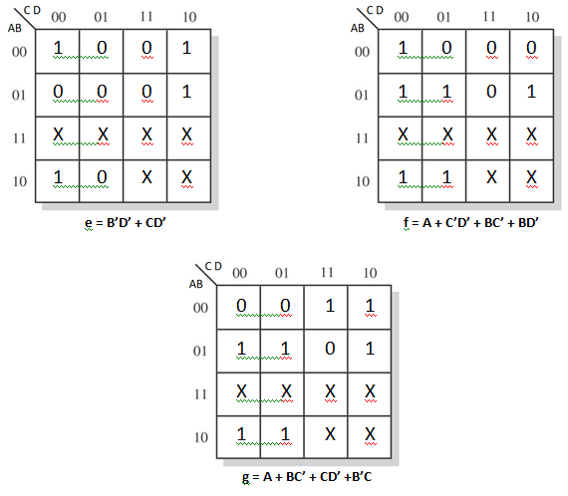
Second project Karnaugh map

Slide 12
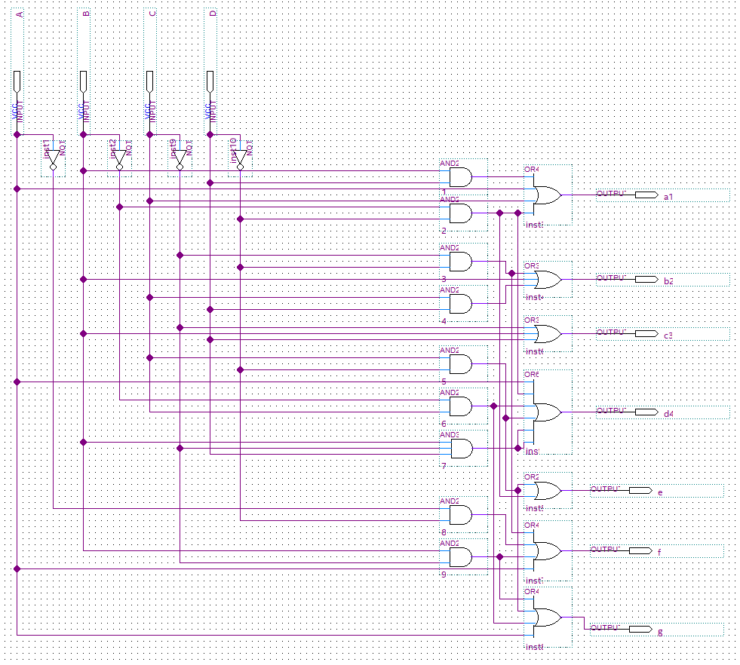
Second project
Gate
realization

Slide 13
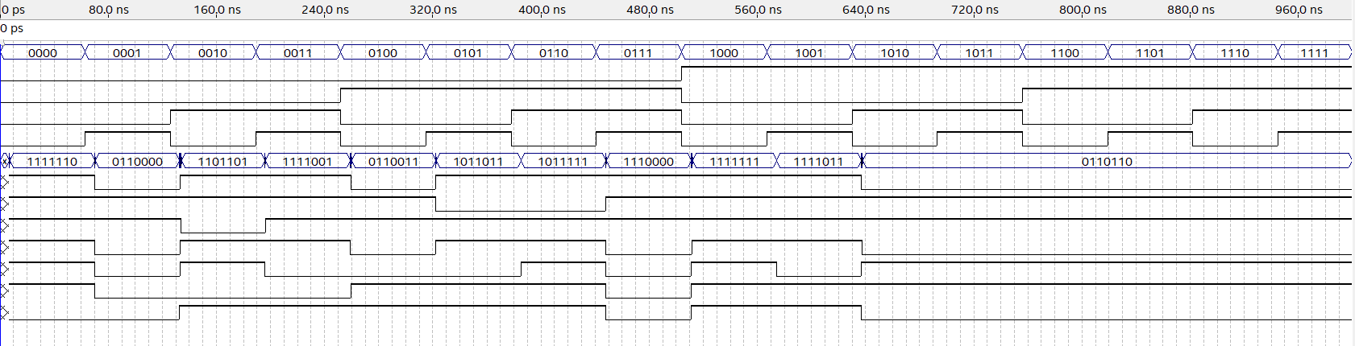
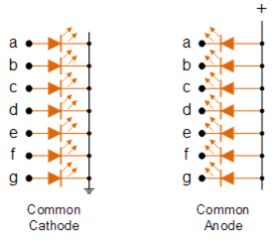
Second project

Slide 14
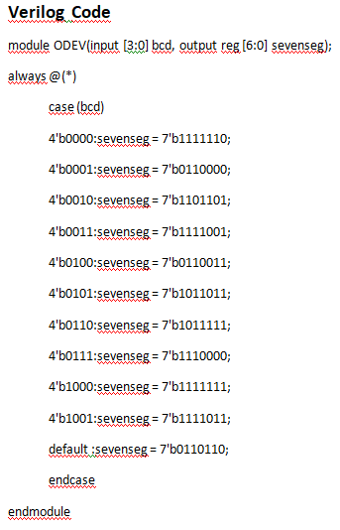
Second project
Verilog
code

Slide 15
Conclusion
In general we saw stage of prepare logic device
In these projects I remembered Verilog language and stages of prepare logic device

